Slide 1
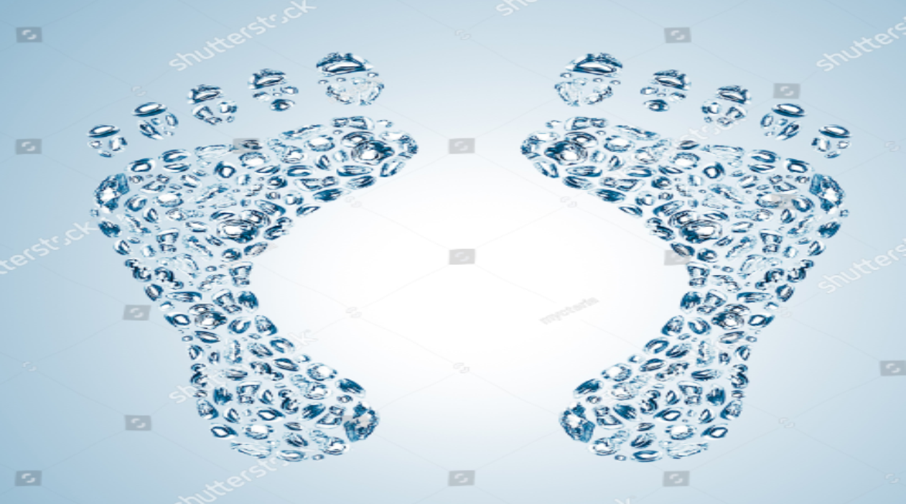
Advancing Water Footprint Analysis in India through Interactive Web Technology
Dr. Sharad K Jain
Indian Institute of Technology, Roorkee
Sharad.jain@ce.iitr.ac.in
Team Members Avi Jain (21113031) Aviral Jain(21113032) Tanuja Kumari (21113166)

Slide 2
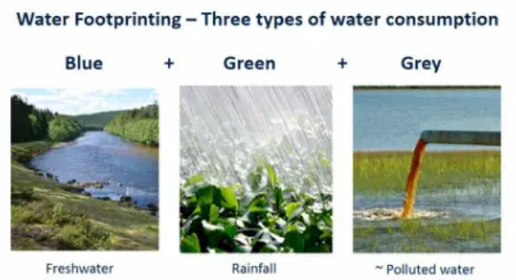
Water Footprint
Water footprint: The volume of freshwater used to produce the product is summed over various production chain steps.
It includes temporal and spatial dimensions: when and where water was used.
Water use is measured in terms of water volumes consumed (evaporated) and polluted.
The total water footprint of a product breaks down into three components: the blue, green, and gray WFP.

Slide 3
Direct And Indirect Water Usage
Direct Water Usage: Water consumption for immediate, identifiable purposes.
Examples: Drinking, cooking, bathing, sanitation.
Indirect Water Usage: Water used in the production of goods and services.
Examples:
Agriculture: Water used to grow crops.
Industry: Water used in manufacturing processes.
Energy Production: Water used in energy generation.
Virtual Water: Water embedded in traded goods.

Slide 4
Types of Water Footprint
Blue Water Footprint: Represents the volume of surface water and groundwater consumed or polluted during human activities.
Green Water Footprint: Refers to the volume of rainwater consumed during the growth of crops and vegetation, excluding runoff.
Grey Water Footprint: Indicates the volume of water needed to dilute polluted water to meet agreed water quality standards for discharge into the natural water system.

Slide 5
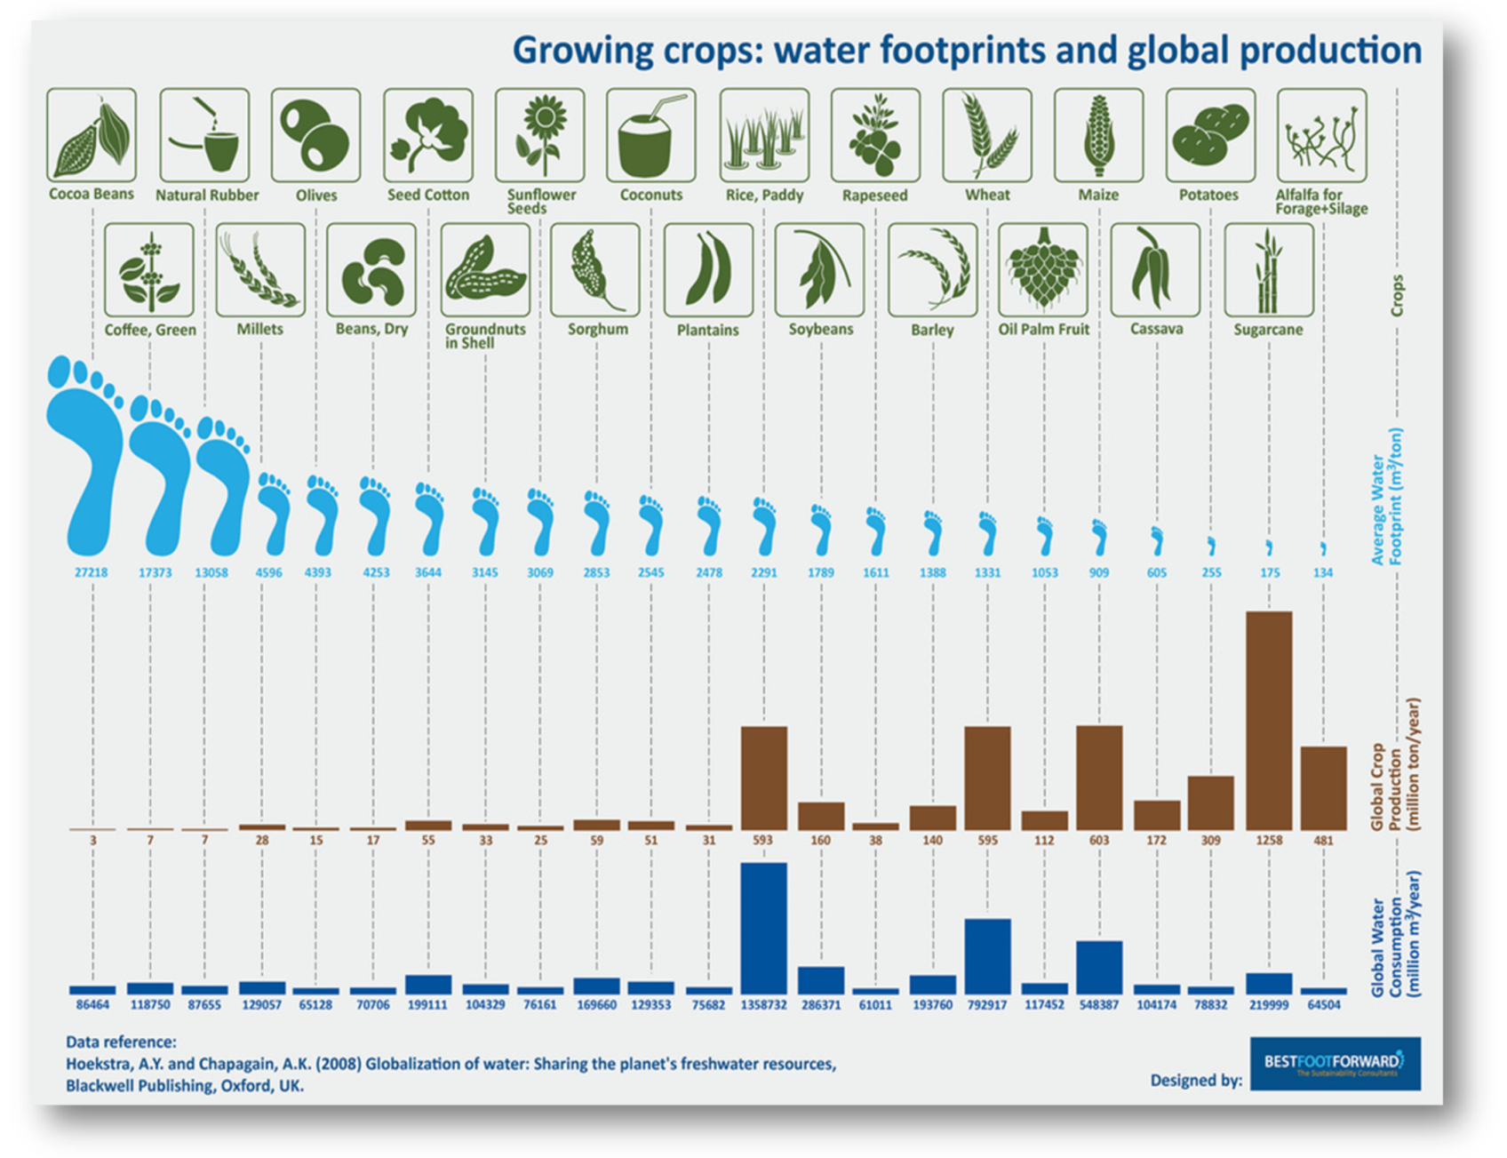
Water Footprint of various crops

Slide 6
Water footprint of a nation or state
Total amount of water used to produce goods and services consumed by the inhabitants of the nation/state.
Components:
Internal water footprint – water use within the country, used to produce goods and services consumed by national population.
External water footprint – annual volume of water resources used in other countries to produce goods and services imported and consumed in country considered.
National/ state water footprint = national /state water use + virtual water (import – export)

Slide 7
Applications of Water Footprint
Assess water consumption patterns and environmental impacts.
Understand national dependency on foreign water resources.
Evaluate sustainability of water consumption in river basins.
Determine company's reliance on scarce water resources in supply chain and assess water usage and pollution during production.
Aid policymakers, researchers, and stakeholders in identifying opportunities for water conservation and sustainable management.

Slide 8
LIVE DEMO!
http://localhost:3000/

Slide 9
Data requirement to estimate Water footprints
•WFP estimation has large data requirements:
•Data from all sectors where water is used.
•Data from all manufacturing sectors, commercial activities.
•Domestic water use, environmental water use, …
Why to estimate Water footprints?
•WFP provide a snapshot of water uses across different sectors, industries, geographical regions, etc.
•WFP estimates are helpful in water planning and management.
•WFP estimates show where water can be saved or is being used wastefully.

Slide 10
Thank You

